Slide 1
Car Prices
Samuel Flusche, Ruben Valdovinos, Natalia Walls

Slide 2
Dataframe
From kaggle, obtained from CarGurus
Originally obtained 66 different columns, and several million rows (10 GB)
We took a random 400,000 rows
Through removing redundant and unnecessary columns we narrowed that down to 32 columns
Many columns are physical descriptors like maximum seating, length, bed height, etc.
Others are circumstantial factors like location, age, amount of owners, etc.
Two key columns are price and savings

Slide 3
Data Cleaning
Our dataset had a large amount of NaN values
Some columns were almost half NaN
For numerical categories we used either the mean or median
For Boolean columns we made NaN values be a third ‘unknown’ option

Slide 4
Goals With Our Models
Finding what model is the most accurate with predicting price of cars.
Decision Tree Regression: SUVs, Pickups, Everything else, All Cars
K Nearest Neighbors Regression: SUVs, Pickups, Everything else, All Cars
Ensemble with Decision Tree Regression and K Nearest Neighbors Regression
Columns Used:
Mileage, Owner Count, Front Legroom, Back Legroom, Width, Height, Length, is_new, horsepower, is_damaged, brand
Many of the categorical columns were very difficult to use in our models

Slide 5
Savings
Initial Idea was to make a model determining whether or not money was saved in the purchase
However the correlation between savings and columns like whether the car was new or damaged was almost 1.0, so a full model was not necessary

Slide 6
Decision Tree Regression

Slide 7
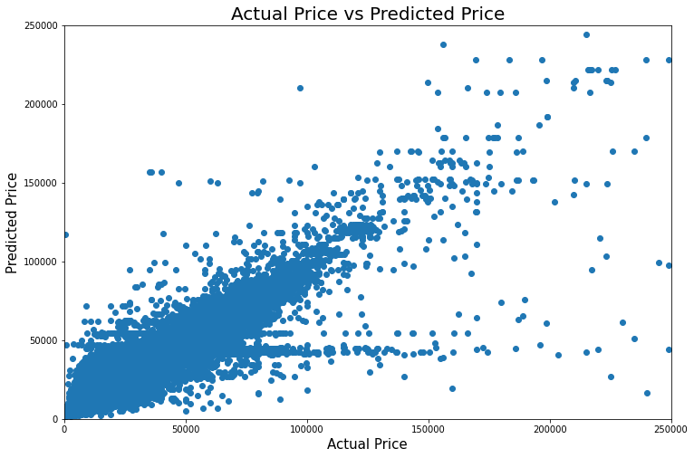
Decision Tree Regression For the whole Data Set
R^2: 79.05%
Max_depth: 18
Min_samples_leaf: 6
Min_samples_split : 17

Slide 8
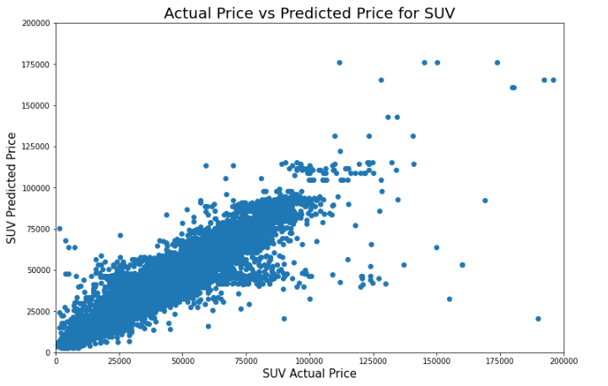
Decision Tree Regression for SUVs
R^2: 87.14%
Max_depth: 48
Min_samples_leaf: 6
Min_samples_split : 24

Slide 9
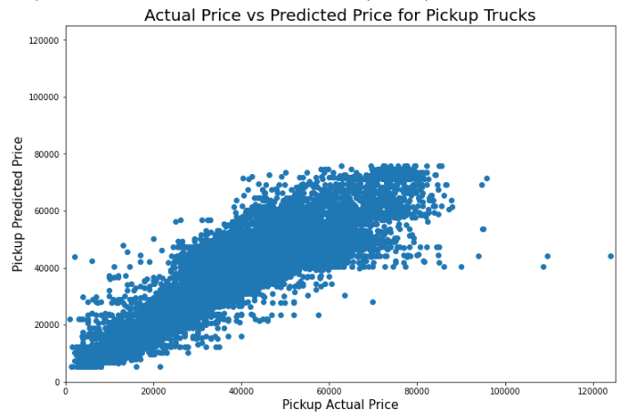
Decision Tree Regression for Pickups
R^2: 75.42%
Max_depth: 47
Min_samples_leaf: 12
Min_samples_split : 105

Slide 10
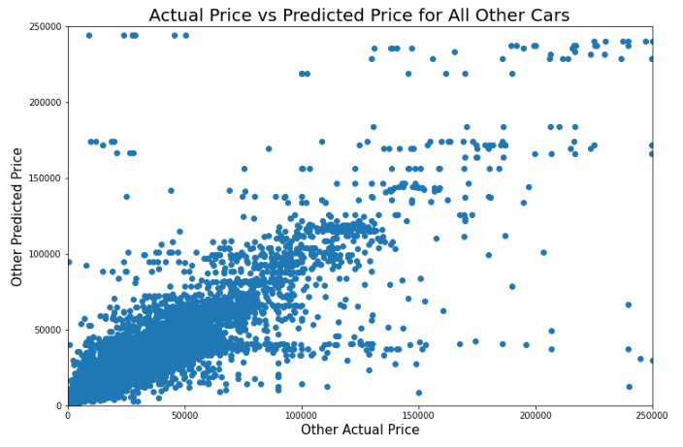
Decision Tree Regression for All Other Cars
R^2: 59.52%
Max_depth: 26
Min_samples_leaf: 10
Min_samples_split : 25

Slide 11
K Nearest Neighbors Regression

Slide 12
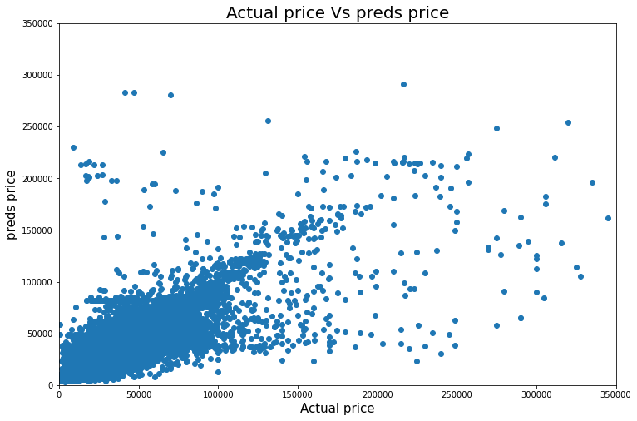
K Nearest Neighbors Regression For the whole Data Set
R^2: 68.76%
N_neighbors : 8
Best metric : euclidean

Slide 13
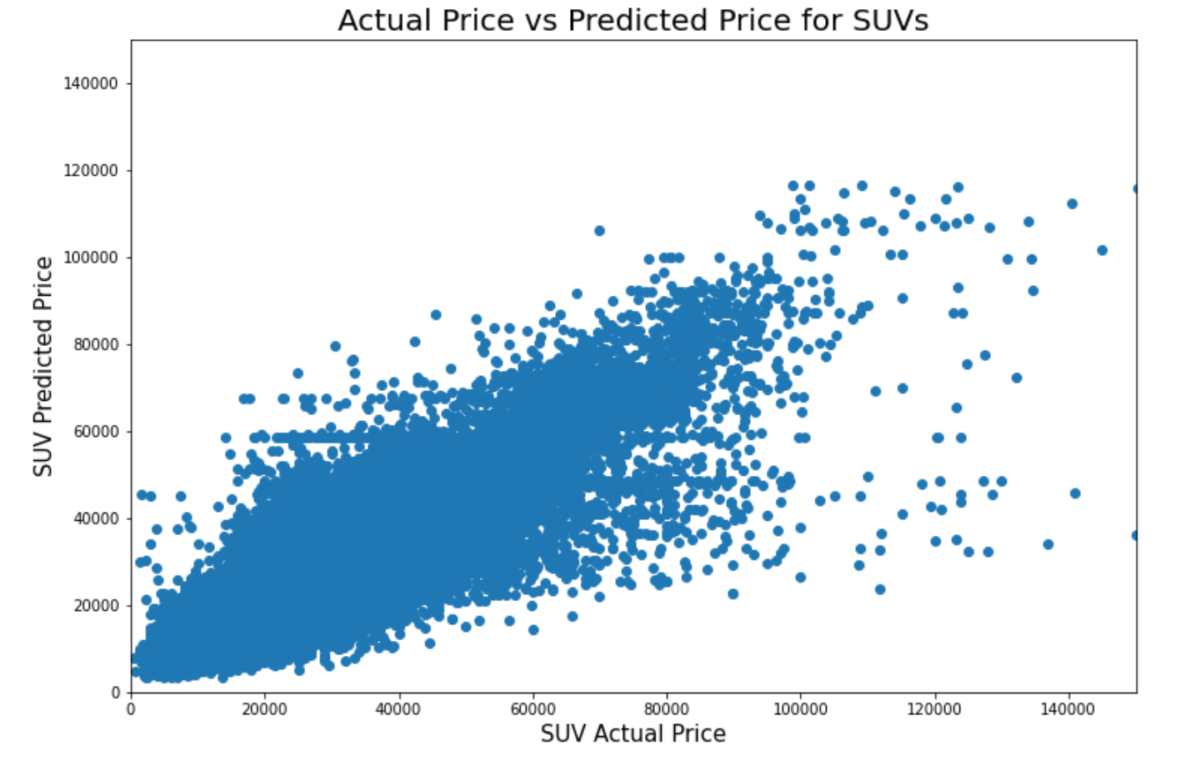
K Nearest Neighbors Regression for SUVs
R^2: 72.42%
N_neighbors : 5
Best metric : euclidean

Slide 14
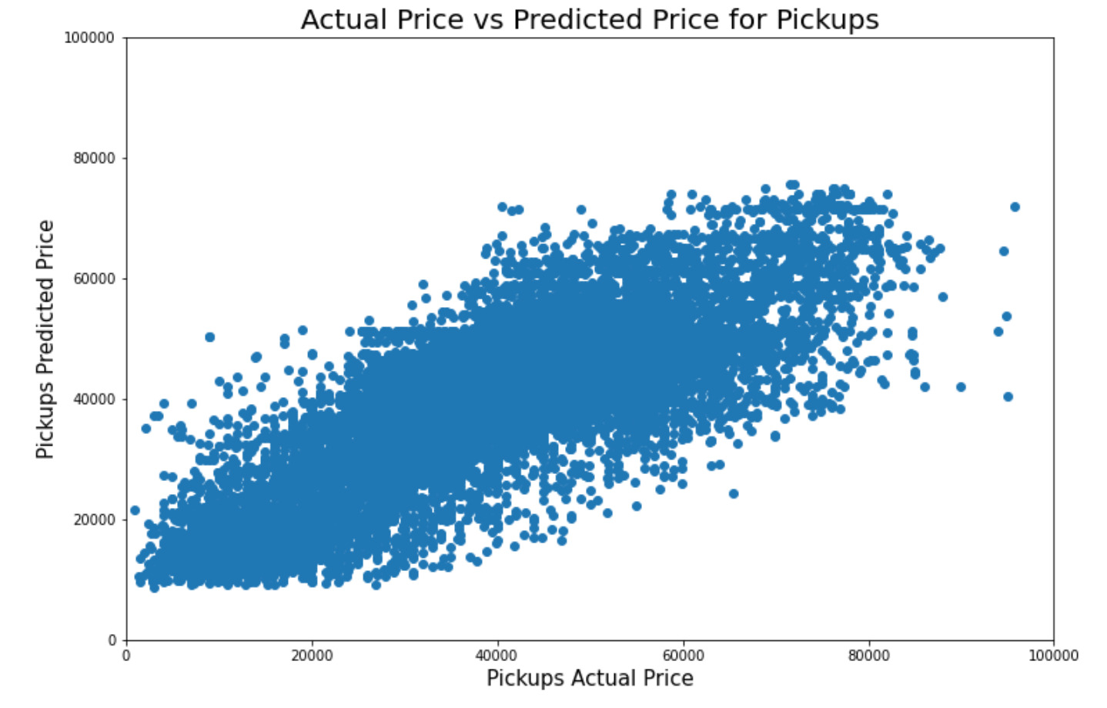
K Nearest Neighbors Regression for Pickups
R^2: 62.78%
N_neighbors : 23
Best metric : euclidean

Slide 15
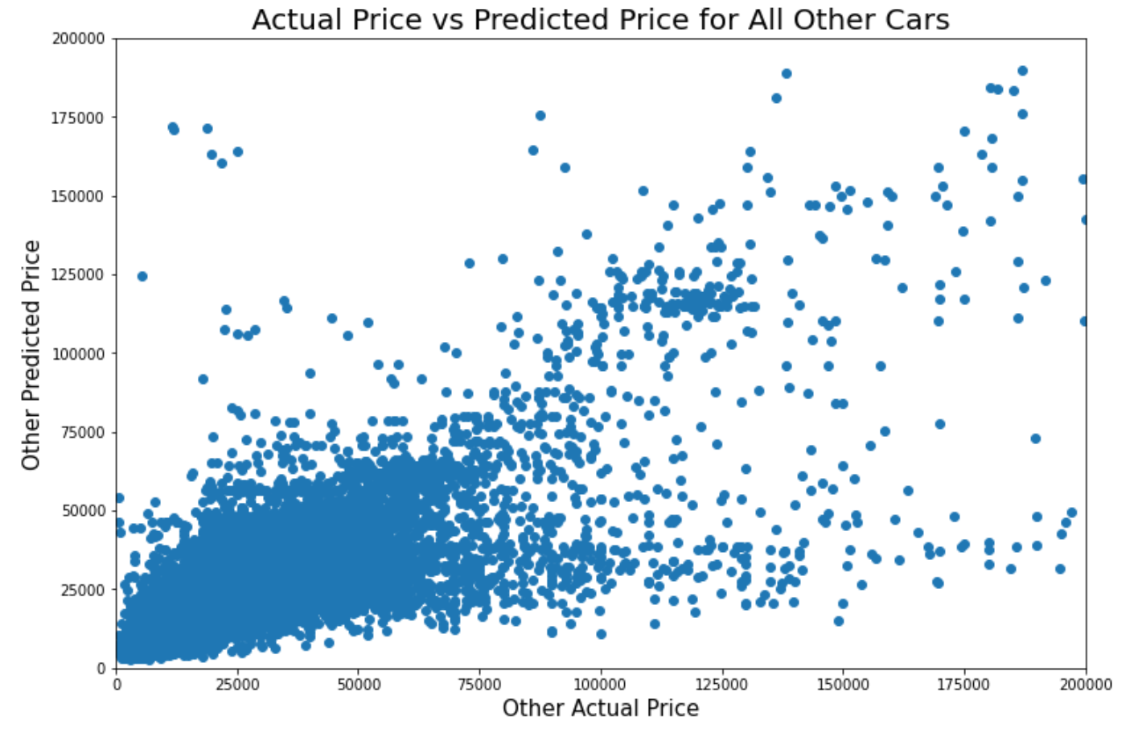
K Nearest Neighbors Regression for All Other Cars
R^2: 41.45%
N_neighbors : 12
Best metric : euclidean

Slide 16
Ensemble

Slide 17
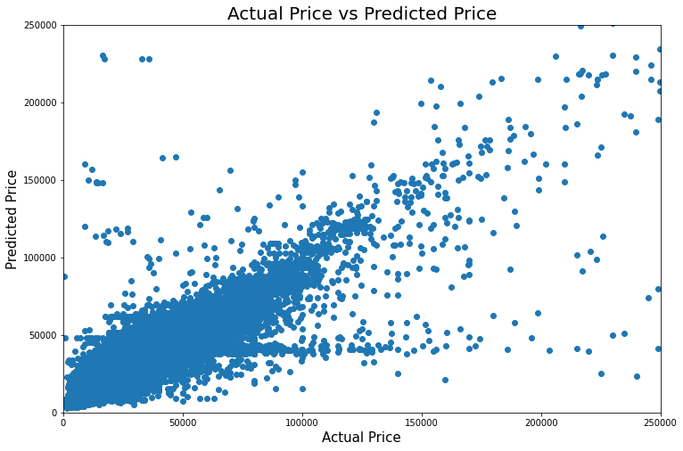
Voting Regression For the whole Data Set
R^2: 77.34%
Used the
K Nearest Neighbors Regression
and the Decision Tree Regression

Slide 18
Conclusion
Voting and nearest neighbor models underperformed
Overall we found that the decision tree regressor was the best model for our data set
Decision tree regressor performed very well when predicting price for all cars but could be improved by splitting up the cars into separate categories
When we did split up the car types into different models could accurately predict SUVs prices up to 87.14% of the time and Pickups 75.42% percent of the time

Slide 19
Thank You!

Slide 20
Next Steps
Look deeper into all our models
Find the best attributes to our model
Further Develop Classifier Model

Slide 21
Decided to Split up the Linear Regression into 3 parts
1: Seller’s Information
Days on Market, Seller Rating, and Owner Count
2: Physical Attributes
Front legroom, Back Legroom, Length, Width, and Height
3: Specs
Mileage, Horsepower, Highway Fuel Economy, Fuel Tank Volume

Slide 22
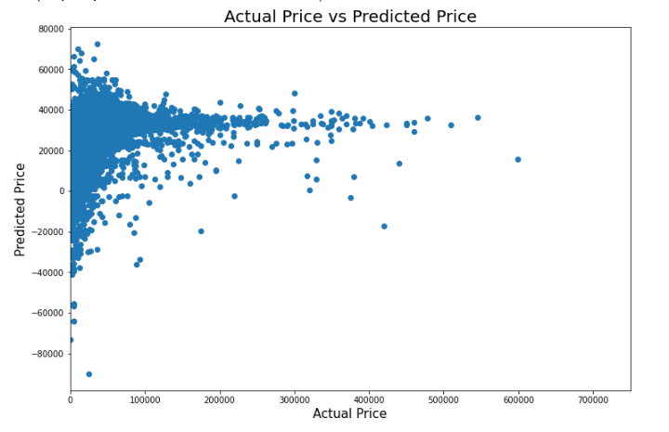
Predicting Price Based on Seller’s Information

Slide 23
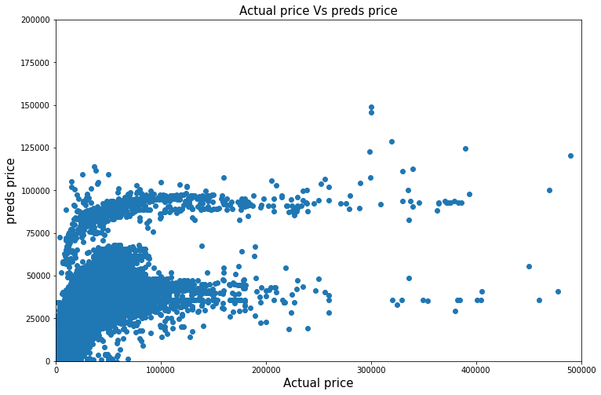
Predicting Price Based on Physical Attributes
Specs
Mileage, Horsepower, Highway Fuel Economy, Fuel Tank Volume

Slide 24
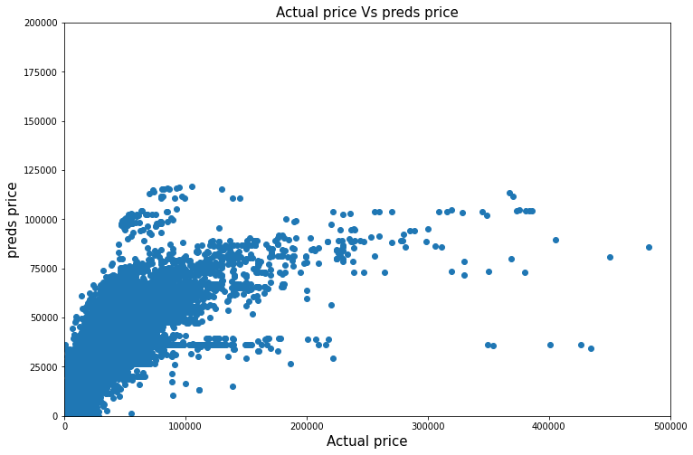
Predicting Price Based on Specs
Physical Attributes
Front legroom, Back Legroom, Length, Width, and Height

Slide 25
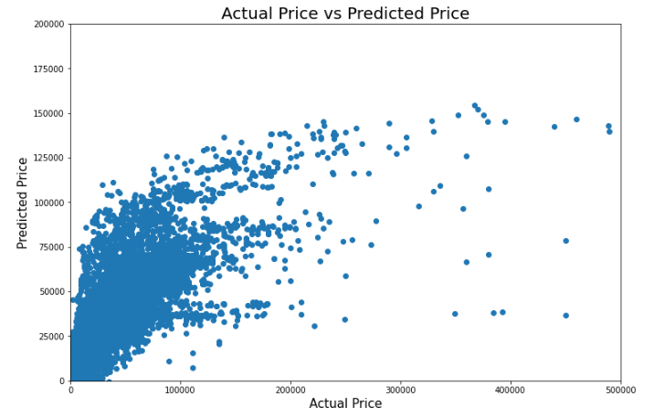
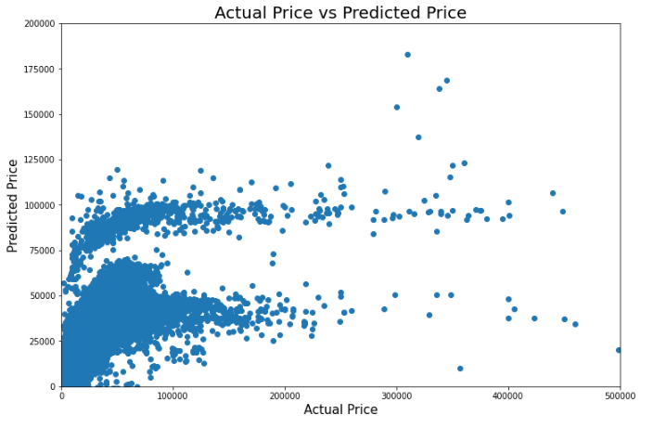
Predicting Prices

Slide 26
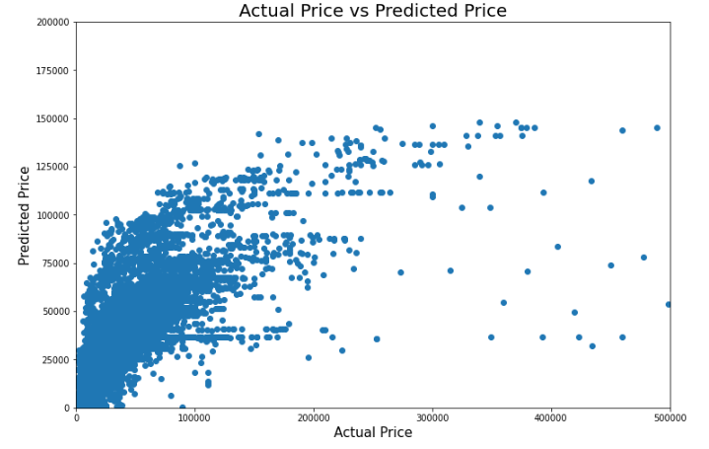
Predicting Using Highest Correlation

Slide 27
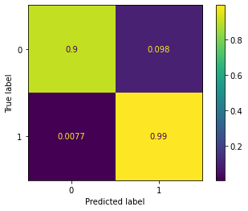
Classifier Model
Initially did a Logistic Regression
For early testing purposes, chose just a few relevant columns out of all of them

Slide 28
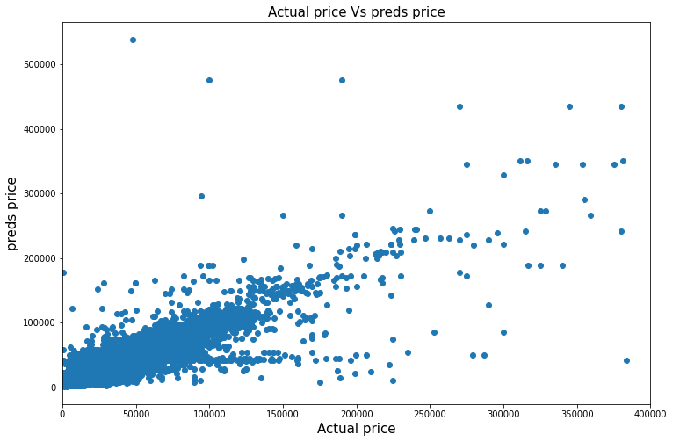
Predicting using Decision tree Regressor
Columns used
Mileage,owner count,front legroom,back legroom, width,height

